Slide 1
Measuring What We Do
Richard L. Wasserman

Slide 2
Why Collect the Data You Generate
Practice promotion
Inform prospective OIT families
Improve patient care
Contribute to the improvement of OIT

Slide 3
Data Collection at Dallas Food Allergy Center
74 Data Elements per Patient

Slide 4
Observations – JACI:IP, 2014
Five OIT centers from two countries using several different protocols
OIT success rate 80%
Epinephrine treated reaction rate during escalation 2/1000 doses
Epinephrine treated reaction rate during maintenance 1/10,000 doses

Slide 5
Observations – JACI:IP, 2018
Asthma was not significantly associated with peanut OIT success
Intermittent asthma was not statistically associated with OIT failure p=0.6
Each year peanut OIT is delayed decreases the likelihood of success by 17%
The risk of epinephrine treated reactions increases with increasing sIgE
The risk of ELORS increases with increasing sIgE

Slide 6
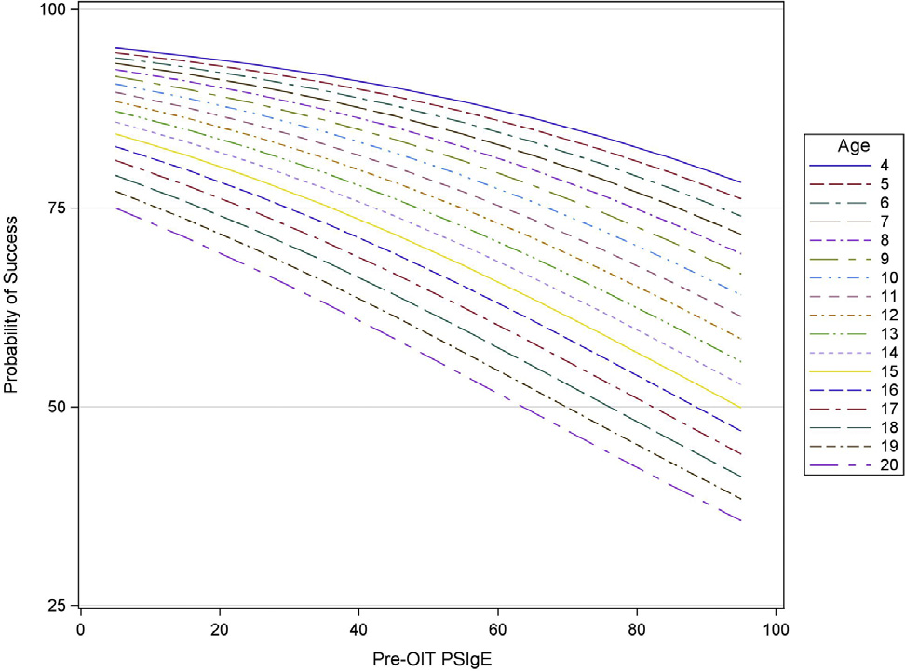
Probability of Reaching the Escalation Target Based on Age and sIgE

Slide 7
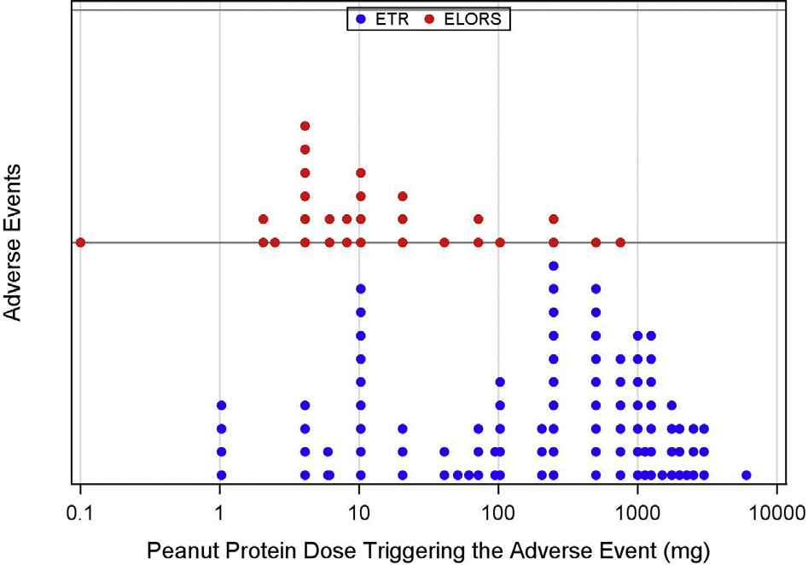
Doses Triggering ELORS and ETRs

Slide 8
Observations – Annals, 2021
>90% of cashew OIT patients pass a pistachio challenge
>95% of walnut OIT patients pass a pecan challenge

Slide 9
Current Observations – Work in Progress
The frequency of ELORS is too high
Atopy and ELORS
History of eczema p<0.001
History of allergic rhinitis p=0.51
History of asthma p=0.99
Atopy and the need for epinephrine
History of eczema p<0.095
History of allergic rhinitis p=0.84
History of asthma p=0.058
Neither history or lab (other than sIgE) predict success
Vitamin D insufficiency and deficiency are common among OIT patients

Slide 10
Data Collection Methods
Extraction from the EMR
Easiest approach to data collection
Most cost effective data collection
Data of interest must be entered as discrete elements
Contemporaneous data entry into a database or spreadsheet
Requires double entry
Reliably captures all the data
Retrospective data entry into a database or spreadsheet
Costly
May miss some patients or data

Slide 11
Legal/Ethical Considerations
Include a sentence or two about data collection in your OIT consent
Data collection for internal use (CQI) requires no IRB review or approval
If you want to report your data
IRB approval is required
Data collection is neither prospective nor interventional
Exempt Research
Collaborate with a local A/I training program

Slide 12
Measure What You Do
When you collect and review your experience,
you improve
Your practice
Your patient care
The practice of OIT Allergy

