Slide 1
OIT Maintenance Options
Richard L. Wasserman, MD, PhD

Slide 2
OIT Goals
Cross contamination protection
Bite proof
Free eating
Sustained unresponsiveness

Slide 3
Dallas Food Allergy Center
Original Protocol
Dose twice a day during escalation and for 3 months on maintenance
After 3 months, dose daily indefinitely
Revised Protocol through 2019
Dose daily during escalation
Dose daily indefinitely or until sustained unresponsiveness challenge
2019 further revisions after FAST meeting

Slide 4
Dave Fitzhugh – Allergy Partners of Chapel Hill
First 6 months maintenance daily
After 6 months of daily maintenance measure sIgE
If the sIgE has decreased by >50% from pre-start, change to 3/7 days a week, typically on a Mon/Wed/Fri schedule
If the sIgE has decreased by 25-50% (i.e., 50-75% of prestart value), change to 5/7 days a week, usually Mon - Fri and weekends off.
If sIgE decrease is <25%, continue daily dosing and recheck in 6 months.

Slide 5
Palforzia
Current label
Daily dosing indefinitely
Alternate maintenance regimens after 1 year of daily dosing
Daily dosing for 28 weeks
Daily dosing for another 56 weeks
Every other day for 4 weeks then twice weekly for 24 weeks
Daily for 4 weeks the every other day for 24 weeks then every other week for 24 weeks
Daily for 4 weeks the every other day for 24 weeks twice a week for 24 weeks

Slide 6
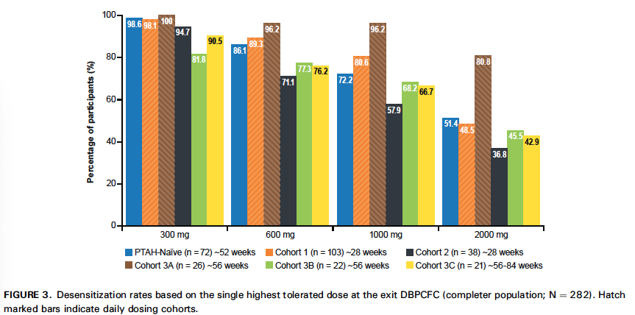
Palforzia Maintenance Frequency Reduction
Daily Dosing

Slide 7
Texas Children’s – Carla Davis, et al
11/17 patients completed
One year biweekly escalation
Maintenance dose – 3,900mg peanut protein
Maintenance schedule – daily for 2 years
Maximum tolerated dose of 26,225mg peanut protein decreased significantly after 1 month avoidance
Most patients had a dramatic fall in sIgE

Slide 8
POISED Study
Treatment for 104 weeks – 4000mg
13 week avoidance or reduced dose (300mg) then challenge with 4000mg
35% of the avoidance group passed
54% of the 300mg group passed
Interpretations
After two years only 35% maintained desensitization for 13 weeks
Reducing maintenance after two years reduces desensitization
Conclusion
Higher maintenance is more effective

Slide 9
Sustained Unresponsiveness - DFAC
Maintenance dosing for at least 3 years
No significant reactions for at least 2 years
If pre-OIT sIgE >10kU/mL and sIgE <2kU/mL
If pre-OIT sIgE <10kU/mL and sIgE <1kU/mL
Significant reduction in SPT
Challenge to 3x maintenance dose
If the challenge is passed, recommend dosing once a week
~90% of DFAC patients meeting these criteria pass
Many eligible patients decline the SU challenge

Slide 10
Is Sustained Unresponsiveness Important?
SU ≠ never allergic ≠ naturally acquired≠ tolerance
What should be the avoidance period prior to SU challenge?
At least two weeks
One month? Three months? Longer?
Common foods – Who cares?
Foods not routinely eaten – How secure can one be?
Is sustained unresponsiveness an artificial research endpoint with no practical clinical relevance?

Slide 11
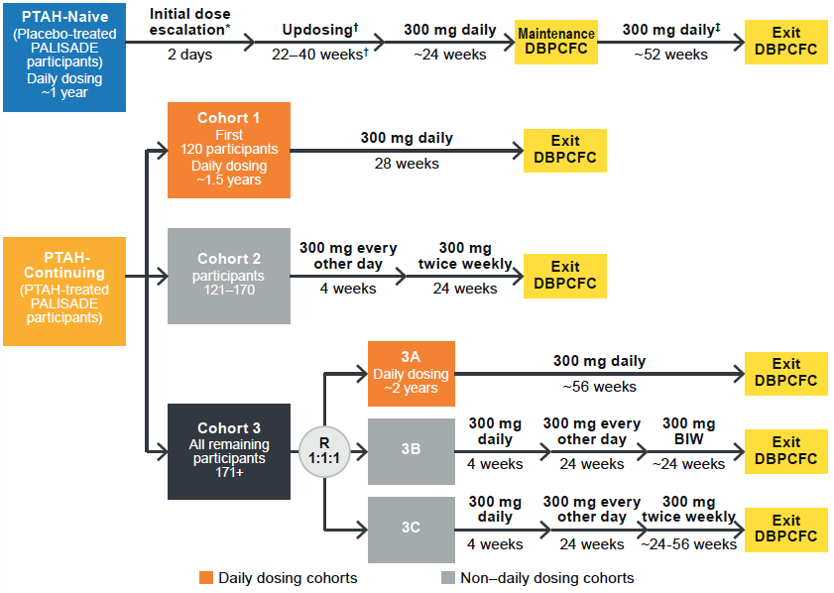
Palforzia Maintenance Frequency Reduction

